Slide 1
Weather Station with Real-Time Rain Prediction and SMS Alerts
A Plug-in Weather Monitoring System
Presented by Ganoy and monday

Slide 2
Introduction
Weather forecasting enables essential and so crucial activities such as agriculture or event planning but often for the people living with centralized systems, these are not real-time when they need it. To fill that gap here is a simple plug-in weather station with the ability to pull in live updates of temperature, humidity, pressure, and rain. The system, which is installed with a standard AC socket for ease of use and maintenance, consists of a GSM module that immediately sends SMS notifications when rain is forecasted or detected. This helps users decide if it's best to act fast in light of local weather information.
Notes:
Plug-in Weather Station for Real-Time Weather Forecasting
• Provides real-time updates on temperature, humidity, pressure, and rain.
• Installed with a standard AC socket for easy use and maintenance.
• Features a GSM module for SMS notifications when rain is forecasted or detected.
• Helps users act quickly based on local weather information.

Slide 3
Significance of the Project
The project offers a user-friendly, real-time weather monitoring solution that provides hyper-local updates, improving safety and decision-making for users.
  Ease of Use – By using a simple plug-in power source, the system is easy to install and maintain without the complexity of solar power or battery management
  Real-Time Alerts: Immediate SMS notifications provide users with timely updates on rain conditions allowing for proactive decisions
  Cost-Effective - The project is cost-effective and suitable for various applications, including personal use and agriculture, as it doesn't require solar panels or batteries.
  Autonomous Monitoring – The system continuously tracks weather data and automatically sends updates via SMS, which requires no manual intervention.
Notes:
The system's simplicity lies in its use of a plug-in power source, making installation and maintenance hassle-free, without the need for complex solar power or battery management.
Real-time SMS notifications offer users immediate updates on rain conditions, enabling proactive decision-making.
The project is cost-effective and suitable for various applications, including personal use and agriculture, as it doesn't require solar panels or batteries.
The system is designed to continuously monitor weather data and send updates via SMS, eliminating the need for manual intervention.

Slide 4
Intended Outcomes
Our goal is to build and deploy an automated weather station with real-time monitoring for weather conditions, that alerts the users through SMS. This means that the system will:
  Track high-level environmental parameters such as temp, humidity, pressure, and rain detection.
  Send SMS alerts for Rain Forecast/Detection and users can do pre-emptive specific handling.
  Offer SMS updates providing the latest weather at each hour.
  Powering from a normal wall socket (standard AC electricity), providing consistent, regular, and constant operation devoid of parts that wear out.
  Easy to set up and maintain, making it more of a backbone solution to urban and rural places with consistent power outlets.
  This plugin weather station provides an easy-to-use, efficient, and reliable way to monitor local weather conditions with quick alerts for real-time changes so that stays ahead of the frequent change in weather.
Notes:
Track environmental parameters such as temp, humidity, and rain
Send SMS alert for Rain forecast/Detection with the ability of pre-emptive handling
SMS update every interval of one hour to provide the latest weather forecast and parameters
Simplicity in operation
Easy to set-up and maintain.

Slide 5
Related Literature
Importance of Weather Forecasting
  Weather forecasting plays a critical role in various sectors, including agriculture and event planning, where timely updates can reduce risks and improve decision-making. Centralized systems often fail to provide real-time, localized data, making it difficult to respond promptly to weather changes. Pujari et al. [3] developed a GSM-based weather station that offers real-time updates on temperature, humidity, and rainfall, ensuring users are informed quickly. Studies on GSM-based weather monitoring systems further highlight how localized updates help users make informed decisions based on accurate weather data [4], [5].
Notes:
Weather forecasting is crucial in agriculture and event planning, but centralized systems often lack real-time, localized data. Pujari et al. developed a GSM-based weather station that provides real-time updates on temperature, humidity, and rainfall, enabling users to make informed decisions based on accurate weather data.

Slide 6
Related Literature
Localized Weather Monitoring
  Localized weather monitoring systems provide real-time environmental data specific to smaller regions, especially where broader centralized systems may not deliver accurate updates. Bharathy [1] implemented a rain sensor module using the LM393 operational amplifier, which measures rainfall by detecting resistance changes. This system transmits real-time data, ensuring immediate responses to rainfall. Similarly, Campbell et al. [2] developed an automatic rain-sensing window mechanism, showcasing how localized monitoring can trigger immediate protective measures, such as closing windows when rain is detected.
Notes:
Localized weather monitoring systems offer real-time environmental data for smaller regions, enabling immediate responses to rainfall. Bharathy and Campbell et al. developed rain sensor modules and automatic rain-sensing window mechanisms, demonstrating how localized monitoring can trigger protective measures, such as closing windows, when rain is detected.

Slide 7
Related Literature
Use of GSM Modules in Weather Stations
  GSM modules play a key role in enabling real-time data transmission, particularly in remote areas with limited internet access. Both Bharathy [1] and Pujari et al. [3] demonstrated the effectiveness of GSM modules in transmitting real-time weather updates via SMS, allowing users to receive critical updates on temperature and rainfall. Additionally, studies have shown that GSM modules can facilitate communication between sensors and users over long distances, making weather data accessible in real-time even in remote locations [4], [5].
Notes:
GSM modules enable real-time data transmission, especially in remote areas with limited internet access. They transmit weather updates via SMS, providing critical temperature and rainfall updates. Studies show GSM modules facilitate communication between sensors and users over long distances, making weather data accessible in real-time even in remote locations.

Slide 8
Related Literature
Monitoring Environmental Factors
  Monitoring environmental factors such as temperature, humidity, pressure, and rainfall is essential for accurate weather forecasting. Bharathy [1] utilized a rain sensor that detects moisture by measuring resistance changes, providing users with real-time rainfall data. Pujari et al. [3] employed sensors to monitor these key factors and used GSM modules to transmit the data, ensuring users can take timely action based on weather conditions. This method of real-time environmental monitoring is essential for proactive decision-making in various fields, such as agriculture [5].
Notes:
Real-time environmental monitoring, including temperature, humidity, pressure, and rainfall, is crucial for accurate weather forecasting. Bharathy and Pujari et al. used sensors to detect moisture and transmit data via GSM modules, enabling timely action in various fields like agriculture. This proactive decision-making method is essential for weather-related decisions.

Slide 9
Related Literature
AC-Powered Weather Stations
  Many weather stations depend on alternative power sources like solar panels or batteries. However, AC-powered systems provide a more stable and reliable solution in areas with constant access to the electrical grid. Pujari et al. [3] implemented an AC-powered weather station that ensures uninterrupted operation and eliminates the need for battery maintenance. Campbell et al. [2] also applied AC power to their rain-sensing windows, which allowed for continuous operation and timely responses during rainfall. Research further supports the advantages of AC-powered systems for long-term data collection and transmission [5].
Notes:
AC-powered weather stations offer a stable, reliable solution for areas with constant electrical grid access. Pujari et al. implemented an AC-powered weather station, eliminating battery maintenance and ensuring uninterrupted operation. Campbell et al. applied AC power to rain-sensing windows, enabling continuous operation and timely responses during rainfall. Research supports AC-powered systems for long-term data collection and transmission.

Slide 10
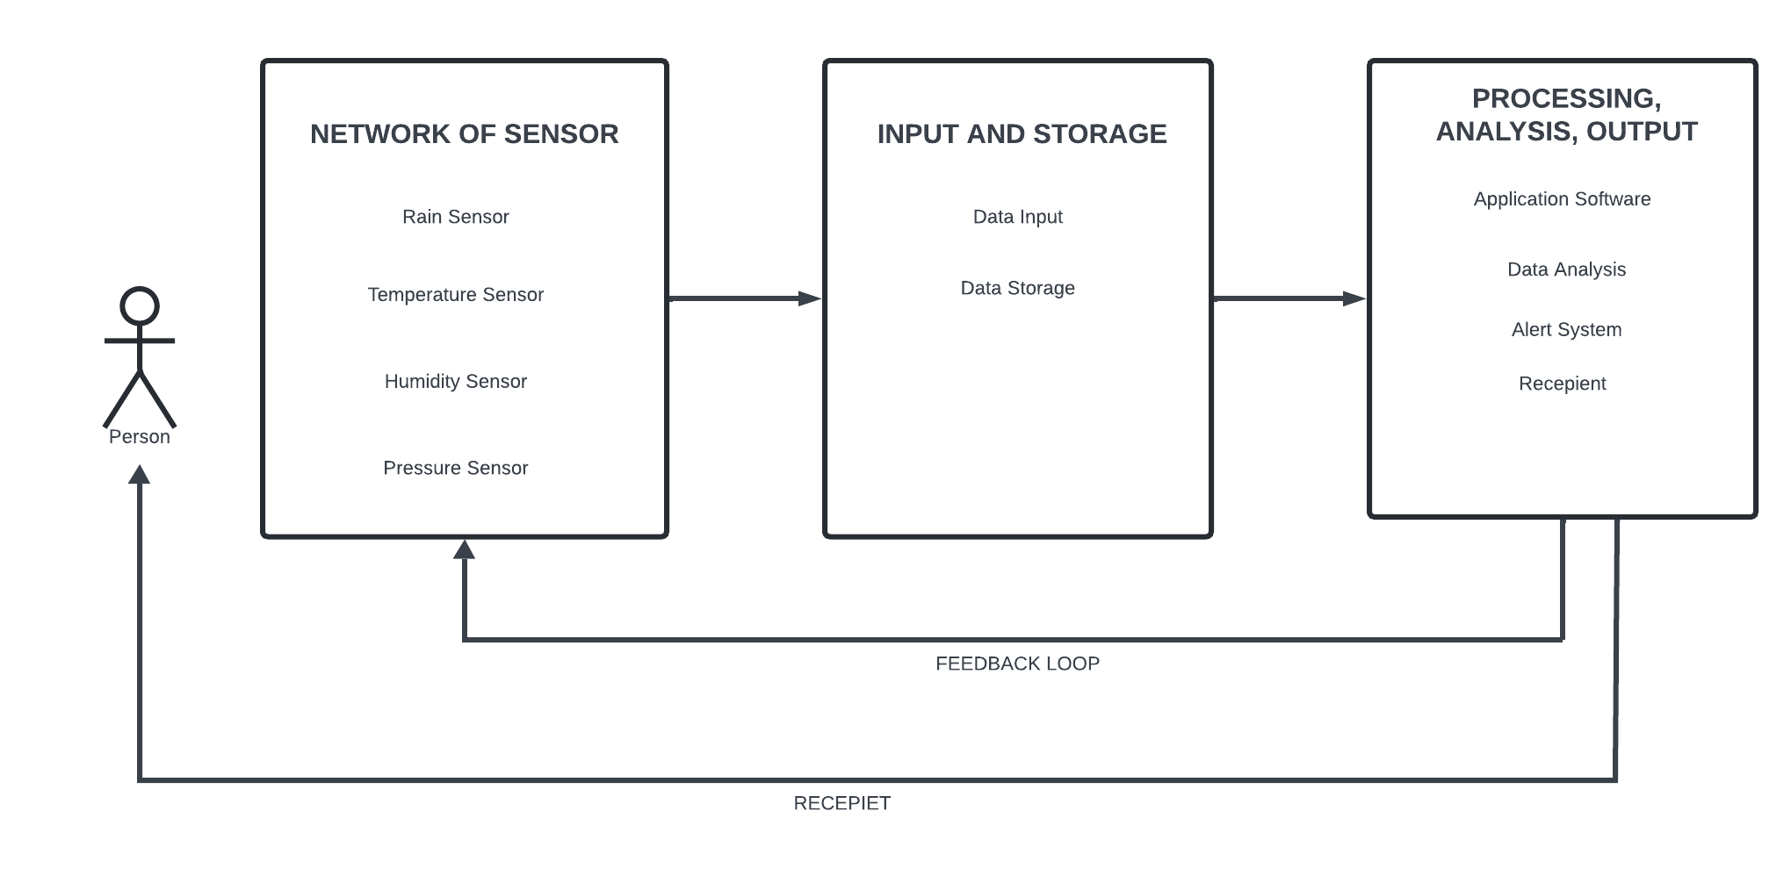
Conceptual Framework
Notes:
Weather Monitoring System Overview
• Network of Sensors: Includes Rain Sensor, Temperature Sensor, Humidity Sensor, and Pressure Sensor.
• Data Input: Raw data from sensors is sent to the system for processing.
• Data Storage: Data is stored for further analysis for pattern recognition and predictions.
• Processing, Analysis, and Output: Application software processes stored and real-time data.
• Data Analysis: The system uses data to detect and predict weather conditions.
• Alert System: If rain is detected or predicted, an SMS alert is sent to the user.
• Feedback Loop: The system uses the feedback loop to adjust sensors or gather more specific data.
• This enhances the system's ability to provide accurate, real-time information by being adaptive to changing weather conditions.

Slide 11
Methodology
The method that will be using in the project is Agile Method. Agile method will let the project test and improve incrementally. The materials that will be included in this project are GMS module, rain sensor, DHT11, BMP280 or BMP180, LCD display, Arduino UNO, and power source.

Slide 12
Methodology
Materials
Materials | Price
DHT11 Temperature and Humidity Sensor | Part of arduino upgraded kit (₱1400-₱1500)
Rain Sensor Module | ₱75
BMP280 Barometric Pressure Sensor | ₱50
Arduino UNO | Part of arduino upgraded kit (₱1400-₱1500)
GSM Module (SIM900/SIM800) | ₱765
LCD i2c Display (16x2) | Part of arduino upgraded kit (₱1400-₱1500)
Waterproof Enclosure | Homemade
Mounting Accessories | Homemade
SIM Card | ₱60
Hall Effect Sensor | ₱150
Magnet | ₱20
Arduino IDE | Free

Slide 13
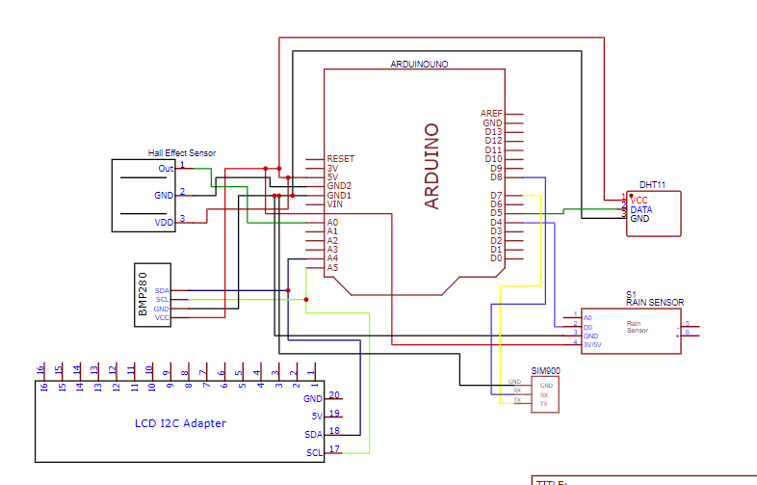
Methodology
Schematic Diagrams

Slide 14
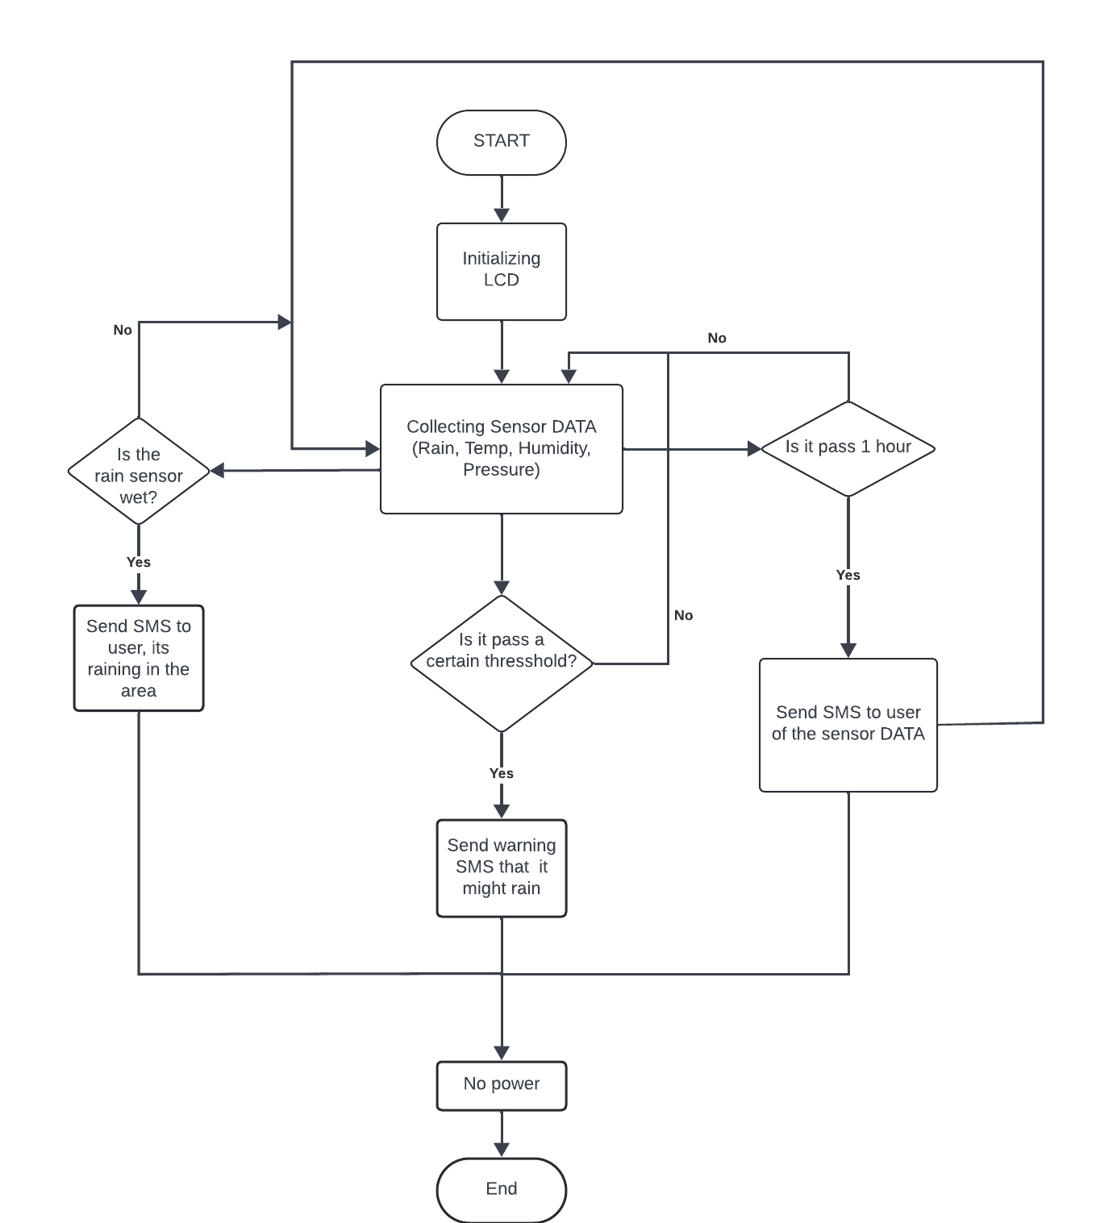
Methodology
Program Flow Charts
Notes:
1. Start:
The system starts when powered on.
2. Initializing LCD:
The first step involves initializing the LCD display to show system status or real-time sensor data.
Once the initialization is complete, the system moves to the data collection phase.
3. Collecting Sensor Data:
The system continuously collects data from the sensors, including:
Rain Sensor (to detect rainfall)
Temperature Sensor
Humidity Sensor
Pressure Sensor
This data is used to monitor the current weather conditions and make predictions.
4. Is the Rain Sensor Wet?:
This decision point checks whether the rain sensor has detected rainfall.
If Yes: The system sends an SMS to the user, notifying them that it is raining in the area.
If No: The system proceeds to the next check for other conditions.
5. Is it Pass 1 Hour?:
The system checks if an hour has passed since the last weather update.
If Yes: The system sends an SMS to the user with the current sensor data (temperature, humidity, pressure).
If No: The system continues monitoring and collecting data.
6. Is it Past a Certain Threshold?:
This decision point checks if any of the weather parameters (temperature, humidity, pressure) have crossed a certain threshold that may indicate upcoming rain.
If Yes: The system sends a warning SMS to the user, notifying them that it might rain soon.
If No: The system continues monitoring without sending a warning.
7. No Power:
If at any point the system loses power, it will stop, and no further operations will occur.
8. End:
The flow ends when the system either stops due to power loss or after successfully sending an SMS update to the user.

Slide 15
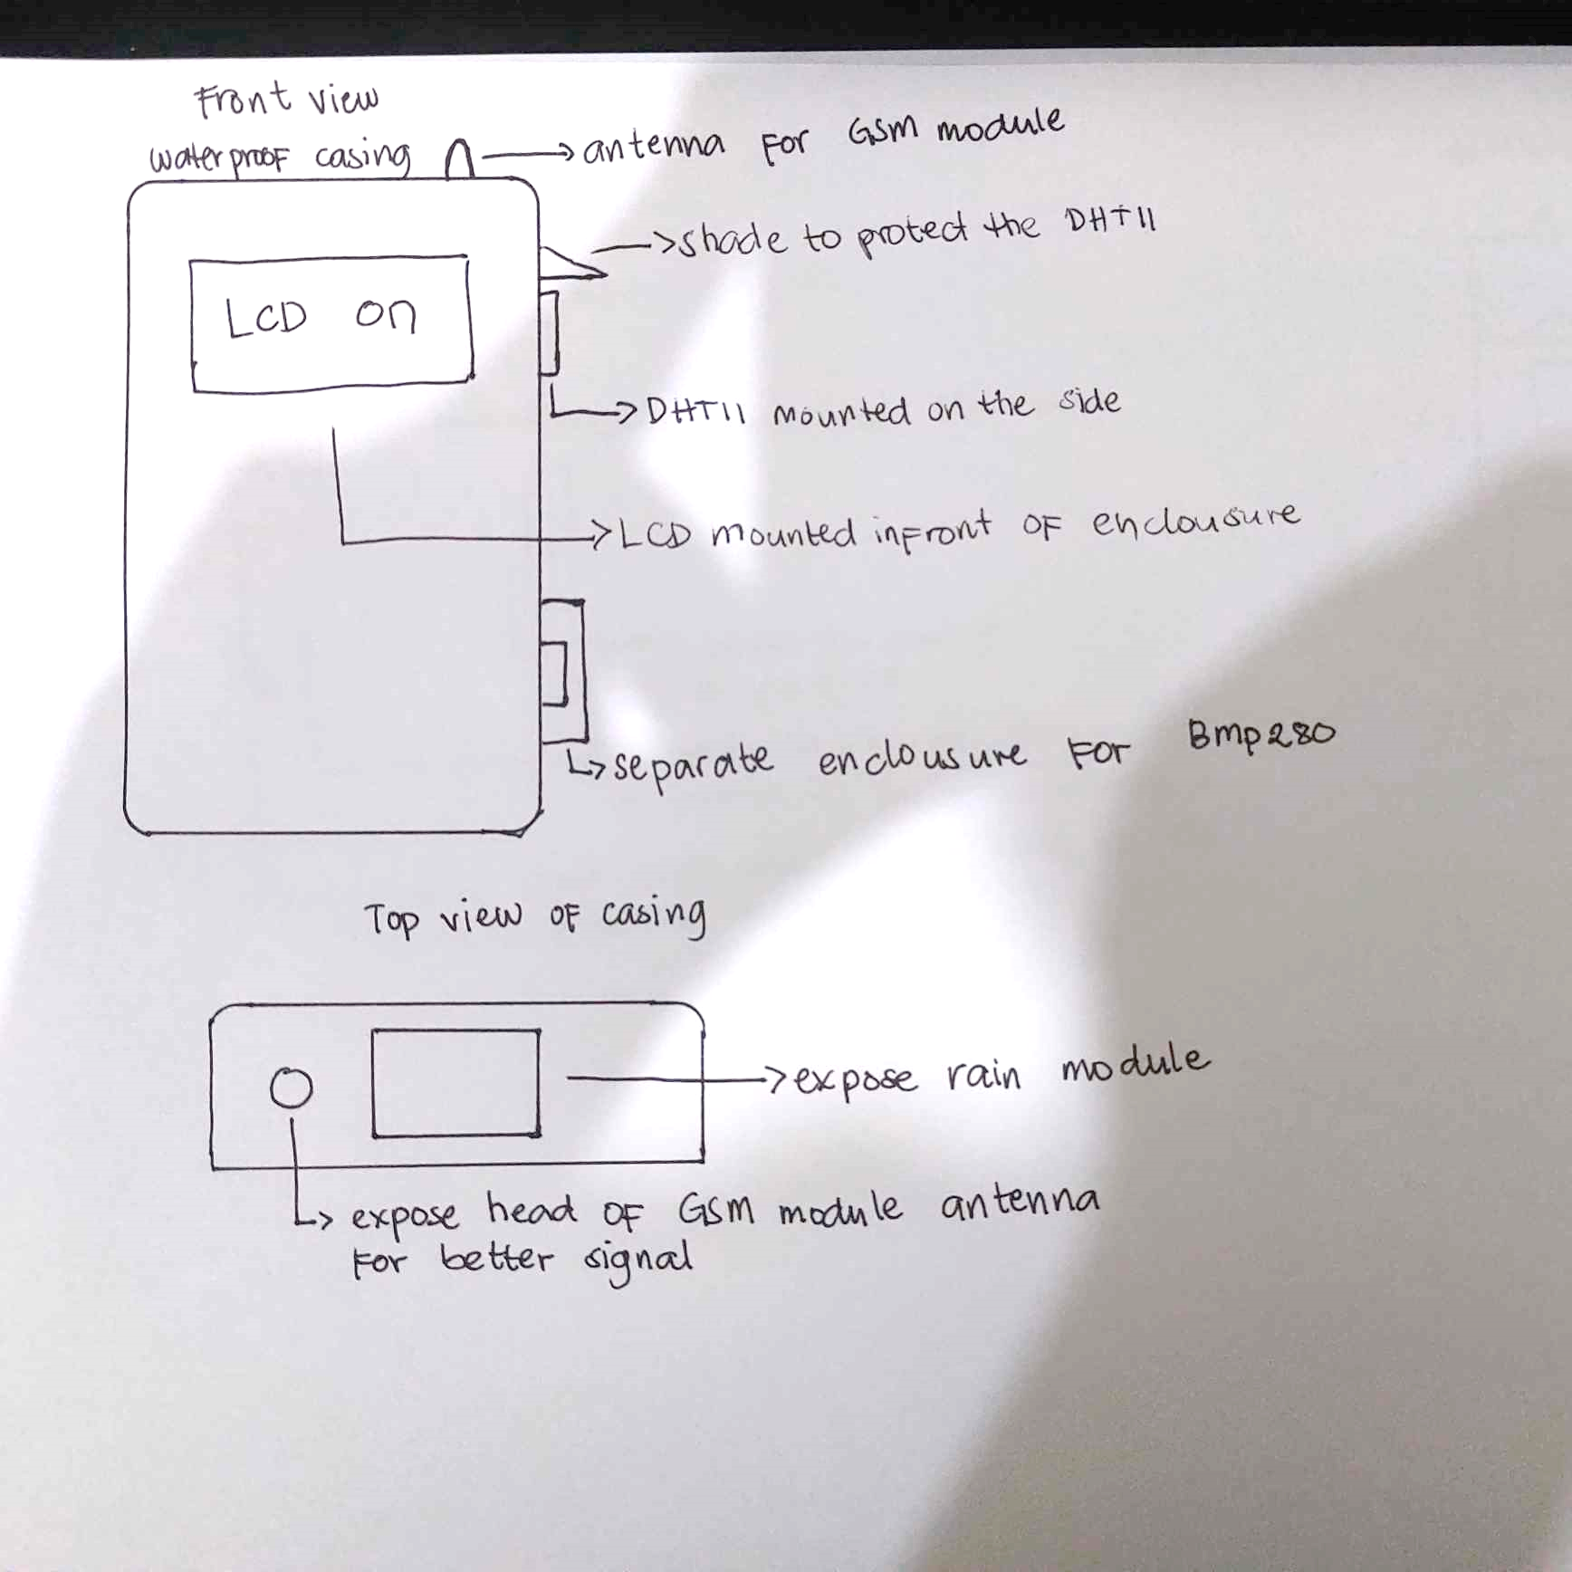
Methodology
Physical Design Plans

Slide 16
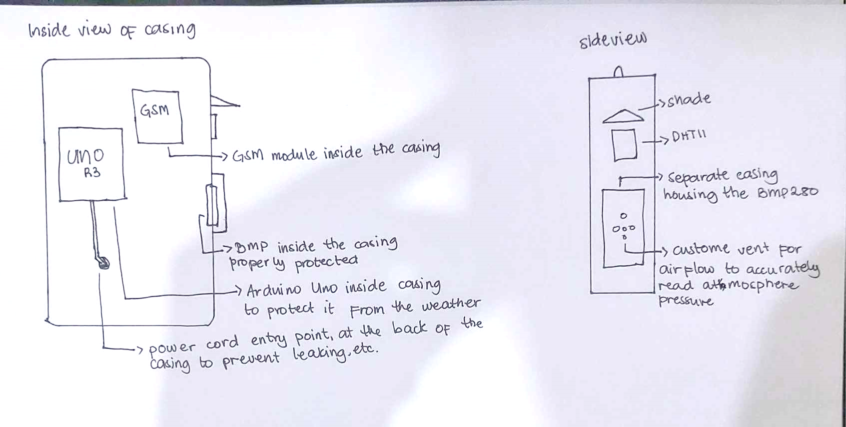
Methodology
Physical Design Plans

Slide 17
Methodology
Physical Design Plans
1 Waterproof Enclosure:
  Houses the core components: Arduino Microcontroller, GSM Module, and Power Supply.
  Protects all internal components from harsh weather conditions.
2 External Sensors:
  Rain Sensor: Mounted on top of the enclosure, fully exposed to rainfall.
  DHT11 (Temperature & Humidity Sensor): Mounted on the side of the enclosure in a shaded area to protect it from direct sunlight and rain, while still capturing accurate environmental data.
  BMP280 Pressure Sensor: Mounted on the side of the enclosure but with vents to allow free airflow for accurate atmospheric pressure readings.
3 LCD Display (Optional):
  Mounted on the front of the enclosure for real-time data display, protected with a weatherproof cover.
4 Power Supply:
  The system is powered by a regular AC socket. The power supply is routed into the enclosure through waterproof cable entry points.
5 Cable Management:
  All cables connecting the sensors, power supply, and the microcontroller are routed through the enclosure with appropriate weatherproof grommets and sealed to avoid moisture ingress.
6 Weatherproofing:
  Ensures all external components and cables are protected from rain, dust, and temperature fluctuations. Silicone seals or weatherproof grommets are used where needed to ensure durability.

Slide 18
Methodology
Role of the Microprocessor.
  The Arduino UNO microcontroller serves as the core of the system, processing data from the rain sensor and making real-time decisions based on the input. It reads the sensor values, determines whether the moisture threshold has been reached, and then activates the appropriate outputs. The microcontroller’s ability to continuously monitor the environment and execute programmed actions makes it an essential component of the rain detection system.

Slide 19
Experimentation
The weather station's experimentation focused on testing and optimizing the DHT11 sensor, GSM module, and anemometer for accurate measurements, reliable data display, and SMS updates.

Slide 20
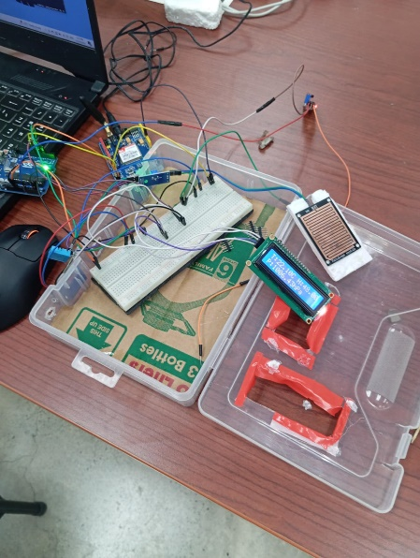
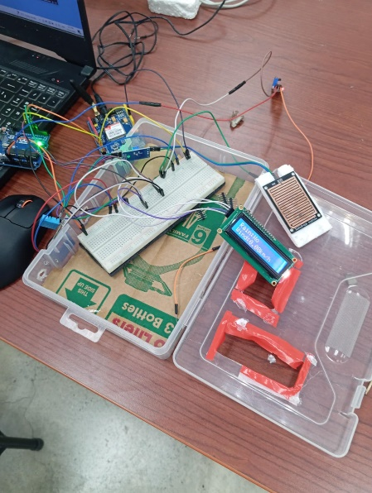
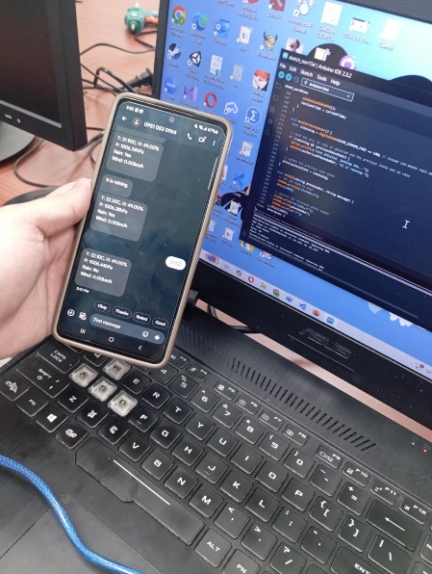
Experimentation
This is the initial testing of all the modules checking if it’s all in working condition.

Slide 21
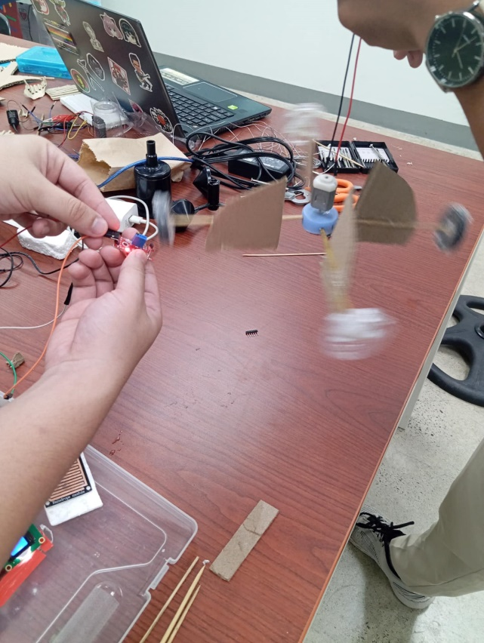
Experimentation
This is our attempt at making our own anemometer by using a hall effect sensor and two magnets attach to the anemometer.
Theoretically, it should measure the wind speed by checking pulses every time the magnet passes by the hall sensor. On its own, we got the sensor to work as intended but when integrating the whole system it would not read properly.

Slide 22
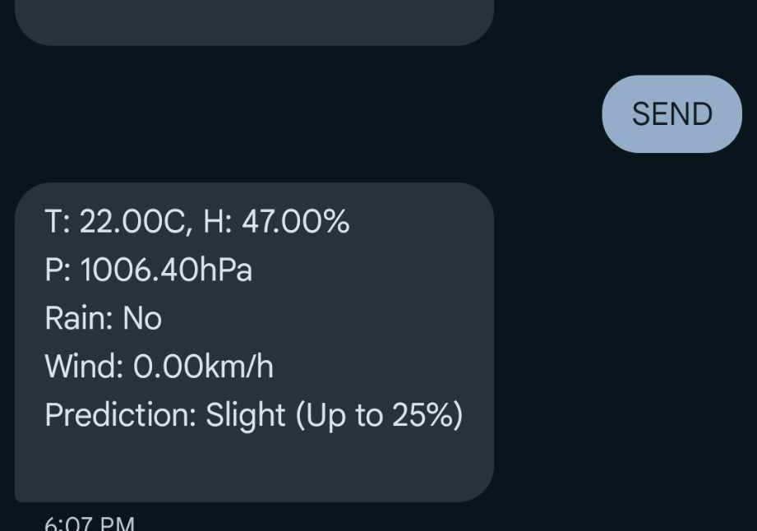
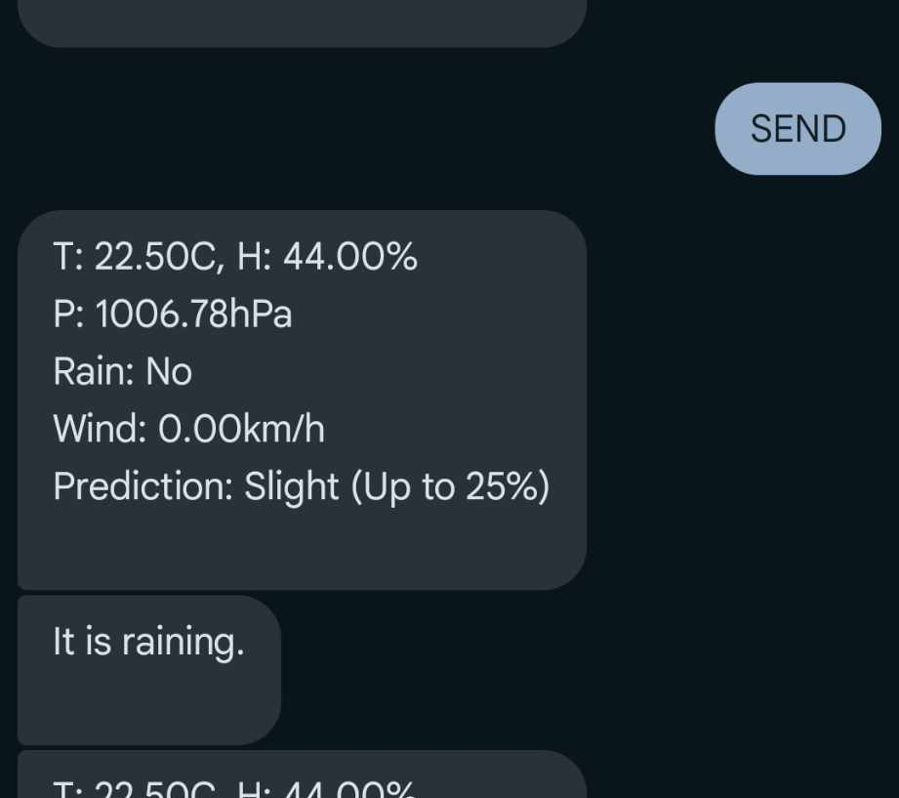
Experimentation
This is the result of our initial testing. If the user text “SEND” to the SMS attached to the system it will send back updates about the current condition of its surrounding
This next test was to ensure that when the rain sensor detects rain drops it will automatically prompt a message to the user that it is raining

Slide 23
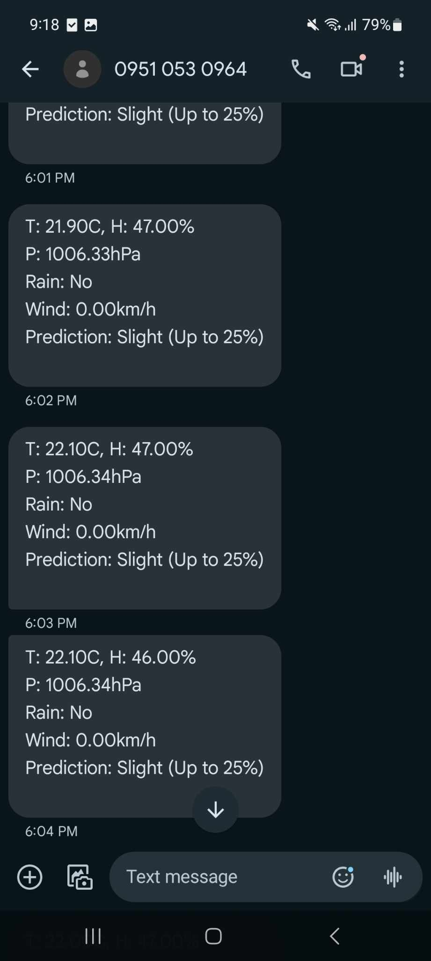
Experimentation
We also made it so that it will prompt a message to the user every one-minute giving updates on the condition of its surroundings. We can adjust the time interval it would need to prompt the next message by changing the time interval in the source code.

Slide 24
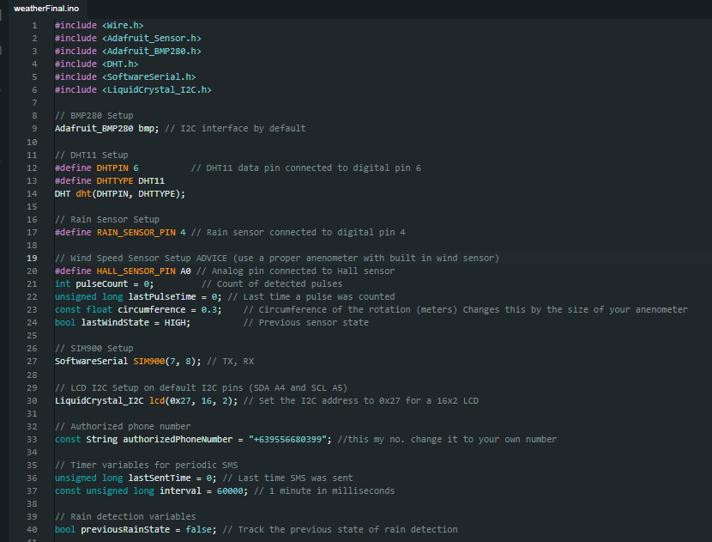
Code:
Initializing all the peripherals and the pins

Slide 25
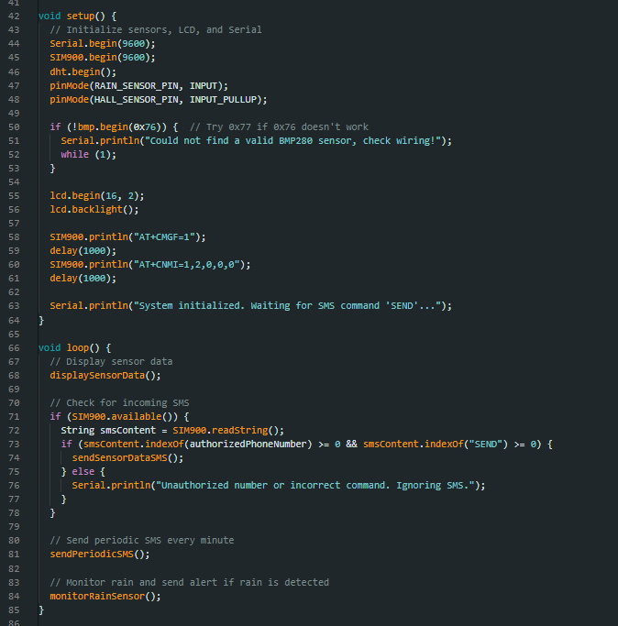
Code
This is how we setup our functions and instruments

Slide 26
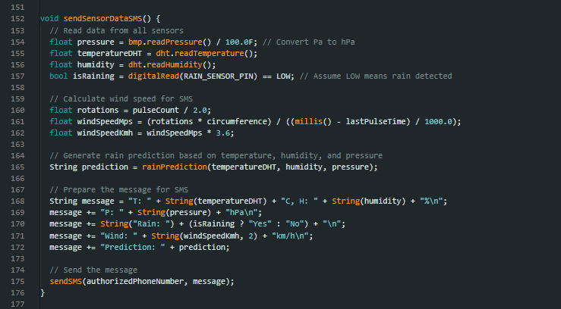
Code
This function tells the sim900 module that this will be the data to be sent to the user once the sendSMS function is called.

Slide 27
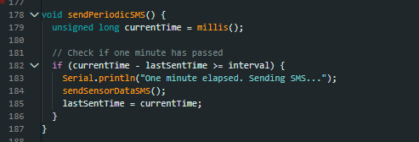
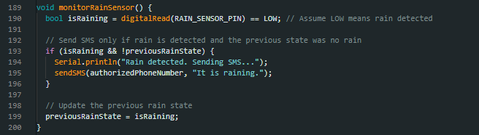
Code
The function that will check if 1 minute has passed by so the system can send another update (time elapsed can be change depending on what the user specifies)
This function is to check if the rain sensor is detecting droplets.

Slide 28
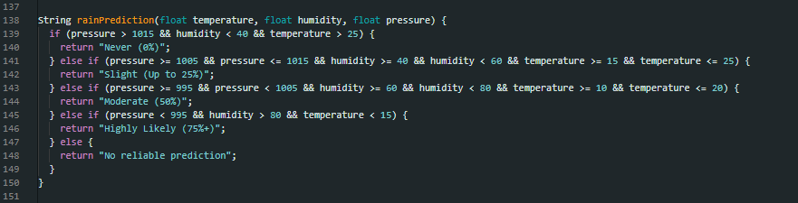
Code
This is the rain prediction formula we use

Slide 29
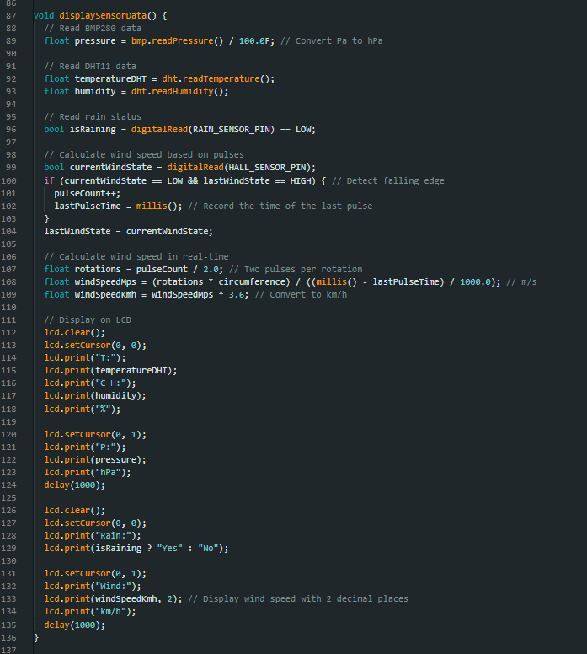
Code
This function is to display the Data to the LCD.

Slide 30
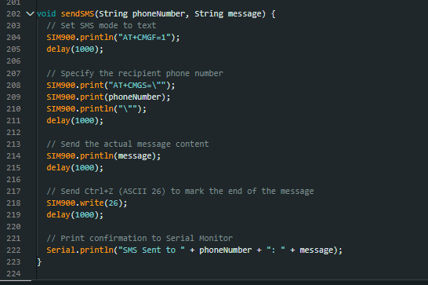
Code
This is the function that will prompt the sim900 module to send the text message to the phone number of the user.

Slide 31
Conclusion
This weather monitoring system combines temperature, humidity, pressure, and rain detection to provide real-time environmental data and rain predictions. By analyzing these factors, the system predicts the likelihood of rain as Never, Slight, Moderate, or Highly Likely. The SMS feature ensures remote access to weather updates, including rain forecasts, enabling users to make informed decisions. Simple yet effective, this system is adaptable for various applications, offering a reliable and cost-efficient weather solution.

Slide 32
Recommendation
Use a proper anemometer, one with an actual wind sensor built-in to it, for convenience and easier coding.
To make a much more accurate weather tracker incorporate a real-time data logging via means of SD card or cloud services for historical analysis.
By adding a wifi module and making it IoT with would make it easier to track and monitor the weather through dashboards or ready-made apps.

Slide 33
References
[1]G.T. Bharathy, Rain Detection System Using Arduino and Rain Sensor, 2021
[2]P. Campbell et al 2005. Automatic rain sensing windows Campbell Scientific, 2005
[3] Pujari, A. K., Patel, S., & Rathi, S. (2022). Wireless weather monitoring system using GSM modules. International Research Journal of Modernization in Engineering Technology and Science. Retrieved from https://www.irjmets.com/uploadedfiles/paper/issue_3_march_2022/20083/final/fin_irjmets1648045248.pdf
[4] Microcontroller-Based Real-Time Weather Monitoring Device with GSM. (2014). ResearchGate. Retrieved from https://www.researchgate.net/publication/264736968_MICROCONTROLLER_BASED_REAL_TIME_WEATHER_MONITORING_DEVICE_WITH_GSM
[5] Design and Implementation of Meteorological Stations with Wireless Data Acquisition System. (2021). ARPN Journal of Engineering and Applied Sciences. Retrieved from https://www.arpnjournals.org/jeas/research_papers/rp_2021/jeas_0321_8525.pdf
[6] Geniezito. (2021). Weather Station Bluetooth. Arduino Project Hub. Retrieved from https://projecthub.arduino.cc/Geniezito/weather-station-bluetooth-f62ce7

Slide 34
References
[7] Derapados. (2021). Weather Station V1.0. Arduino Project Hub. Retrieved from https://projecthub.arduino.cc/derapados/weather-station-v10-f1342f
[8] Anderson Bricker. (2021). Remote Weather Station. Arduino Project Hub. Retrieved from https://projecthub.arduino.cc/Anderson-Bricker/remote-weather-station-ecc8da
[9] Rajeshjiet. (2021). IoT-Based Weather Monitoring System Using Arduino. Arduino Project Hub. Retrieved from https://projecthub.arduino.cc/rajeshjiet/iot-based-weather-monitoring-system-using-arduino-a3334a
[10] American Meteorological Society (AMS). (2014). A Method for Forecasting Precipitation Using Statistical Analysis. Weather and Forecasting, 29(4). Retrieved from https://journals.ametsoc.org/view/journals/wefo/29/4/waf-d-13-00087_1.xml?tab_body=pdf

Slide 35
Source Code
This is my personal Github account where you can find the source code for this project:
https://github.com/kaxanni/Remote-weather-station

Slide 36
THE END
THANK YOU FOR LISTENING

